Slide 1
Team Red Exercise 3
Cornelis Doorenbos, Shushan Toneyan, Julia Eigenmann, Lars Vögtlin, Mili Biswas, Joel Niklaus

Slide 2
Contents
Used Libraries
Tasks
  Image Binarization
  Image Cropping
  Feature Normalization
  Feature Extraction
  Dynamic Time Warping
  Evaluation

Slide 3
Used Libaries
Python 3.6.4
Scikit Learn (sklearn)
Numpy
Pickle
PIL
Svgpathtools for reading polygons from svg

Slide 4
Image Binarization
Otsu Binarization
DIVA Services
  Makes Document Image Analysis methods accessible over the web

Slide 5
Image Cropping
Read the polygons for the words from the svg file (svgpathtools)
  Worked fine
Crop the document based on these polygons (PIL)
  Did not work unfortunately: Always filled polygon with black pixels
  For each word we got the entire document with empty pixels outside the polygon and black pixels inside the polygon → should compute rectangular boundary around polygon and only save this as small image

Slide 6
Feature Normalization
Data normalization is a preprocessing technique usually employed before feature selection and classification. Complex real time pattern recognition systems use features that are generated by many different feature extraction algorithms with different kinds of sources. These features may have different dynamic ranges.Thus with features with large values may have larger impact in the cost function than features with small values. This problem is overcome by normalizing the features so that their values lie within similar range.However, appropriate choice of normalization technique and normalization range is an important issue, since, applying normalization on the input could change the structure of data and thereby affecting the outcome .
Here we have used the most straightforward technique to normalize the features (Z- score normalization)
it is a linear technique in which, initially, mean and standard deviation of the feature vaues are computed.

Slide 7
Feature Normalization
Linear Normalization Technique

Slide 8
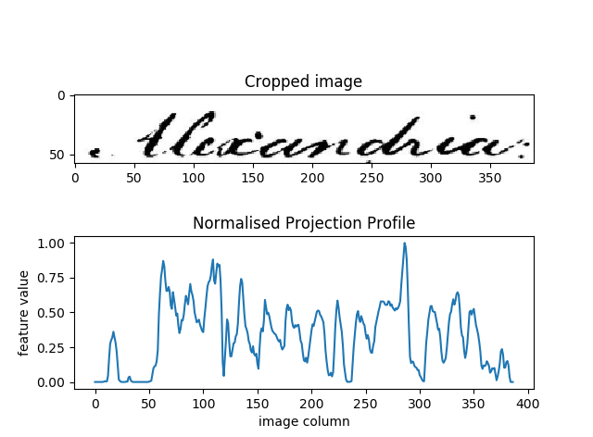
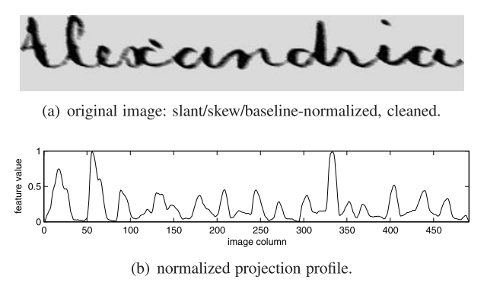
Feature Extraction

Slide 9

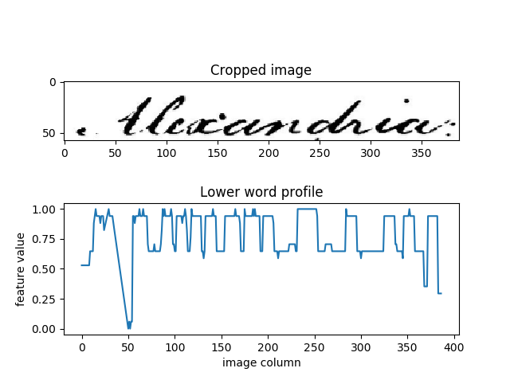
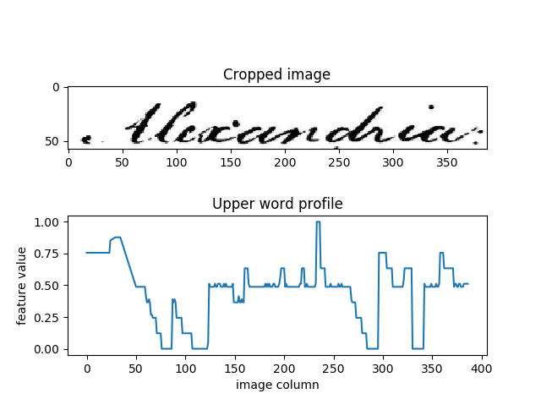
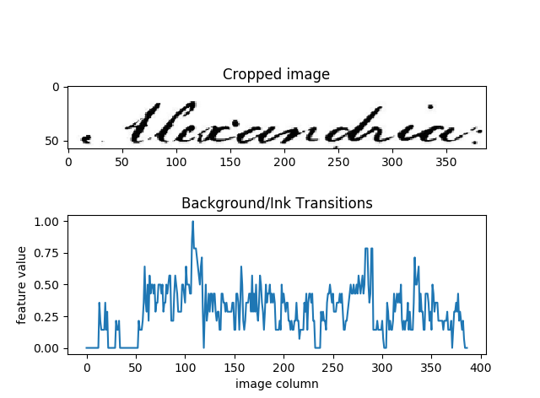
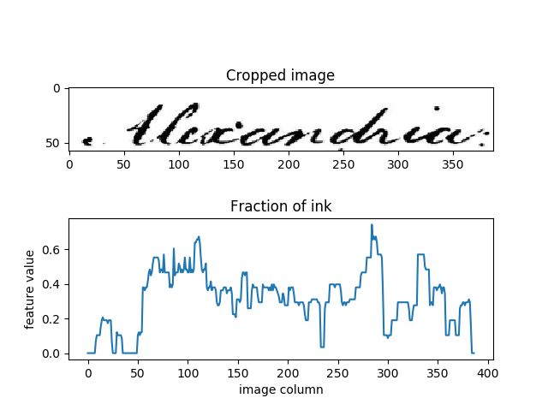

Slide 10
Dynamic Time Warping
Read the polygons for the words from the svg file (svgpathtools)
  Worked fine
Crop the document based on these polygons (PIL)
  Did not work unfortunately: Always filled polygon with black pixels
  For each word we got the entire document with empty pixels outside the polygon and black pixels inside the polygon → should compute rectangular boundary around polygon and only save this as small image

Slide 11
Distance Matrix
 |  |  | 1 | 4 | 5
 |  | 3 | 4 | 3 | 1
 | 3 | 1 | 3 | 4 | 2
2 | 2 | 2 | 2 | 5
2 | 4 | 4 | 1
3 | 1 | 1

Slide 12
Distance Matrix
 |  |  | 1 | 4 | 5
 |  | 3 | 4 | 3 | 1
 | 3 | 1 | 3 | 4 | 2
2+2+3 | 2 | 2 | 2 | 5
2+3 | 4 | 4 | 1
3 | 1 | 1

Slide 13
Distance Matrix
 |  |  | 1 | 4 | 5
 |  | 3 | 4 | 3 | 1
 | 3+7 | 1 | 3 | 4 | 2
7 | 2+5 | 2 | 2 | 5
5 | 4+3 | 4 | 1
3 | 1+3 | 1

Slide 14
Distance Matrix
 |  |  | 1+3+8 | 4 | 5
 |  | 3+8 | 4+1+7 | 3 | 1
 | 10 | 1+7 | 3+2+1+5 | 4 | 2
7 | 7 | 2+7 | 2+1+5 | 5
5 | 7 | 4+4 | 1+5
3 | 4 | 1+4

Slide 15
Distance Matrix
 |  |  | 12 | 16 | 18
 |  | 11 | 12 | 14 | 13
 | 10 | 8 | 11 | 12 | 13
7 | 7 | 9 | 8 | 11
5 | 7 | 8 | 6
3 | 4 | 5

Slide 16
Evaluation
Recall: How many of the relevant are selected
Precision: How many selected items are relevant?

Slide 17
Evaluation
Recall: TP / (TP + FN)
Precision: TP / (TP + FP)

Slide 18
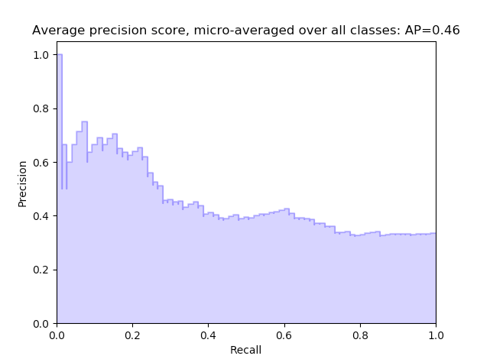
s

Slide 19
Lessons Learned
Don’t trust Joel!!!

Slide 20
Questions???

